Slide 1

Web Essentials: From Code to Career
A 3 Day Hands On Workshop – Day 1
Welcome !!
Get Ready to Build the Web !!

Slide 2
What Will We Learn?
A hands-on, beginner-friendly program
Core technologies of modern web development
Build websites from the ground up
Connect Frontend (what you see) with Backend (the logic)
Understand how data flows between browsers, servers, and databases

Slide 3
Our Toolkit
Frontend
Backend
Tools
HTML
CSS3
JavaScript
JSP (Java Server Pages)
MySQL Database
Apache Tomcat
VS Code
MySQL Workbench

Slide 4
By the End, You Will Be Able To...
Master the building blocks: HTML, CSS, JavaScript
Design interactive and responsive user interfaces
Create dynamic web content and handle user input
Connect Frontend & Backend using JSP
Use MySQL for data storage
Build and deploy your own mini web application

Slide 5
The Magic Behind Websites
The Internet is a global network of computers
They communicate using HTTP
Your browser (Chrome, Edge) requests web pages from a server
Let's break down what happens when you type a URL...

Slide 6
What Happens When You Visit a Website?
You type: www.google.com
DNS converts it to an IP address
Your browser sends a request to the server
The server processes the request (may talk to a database)
The server sends back HTML, CSS, JS
Your browser renders the page

Slide 7
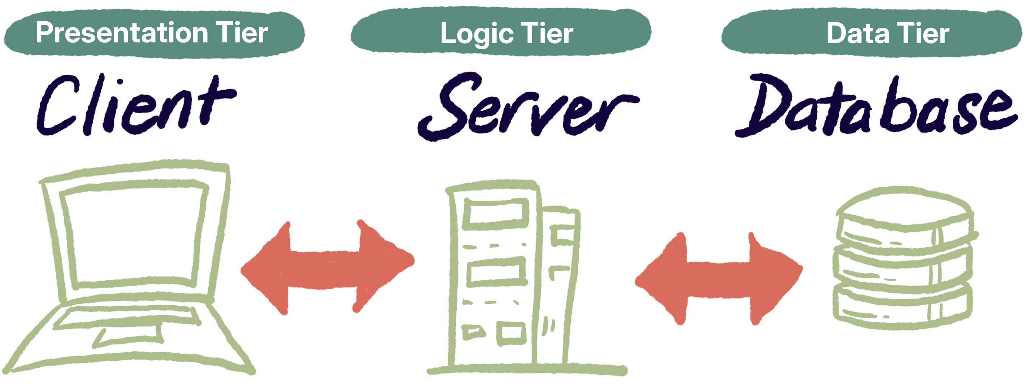
The Foundation of the Web
Component | Description
Client (Frontend) | Your browser. Displays content & handles user actions (clicks, forms).
Server (Backend) | Where the logic lives. Processes requests and decides what information to send back.
Database | Stores application data (user details, products, etc.).

Slide 8
The Request-Response Cycle
User Action: Clicks a button or submits a form
Request Sent: Browser sends HTTP request to server (e.g., /login.jsp)
Server Processes: JSP + Java connect to MySQL, get/store data
Response Returned: Server sends back HTML, JSON, or a redirect
Browser Updates: User sees the result

Slide 9
Becoming a Full-Stack Developer
Frontend Developer: Builds what users see and interact with (UI/UX).
Backend Developer: Builds the server, database, and application logic.
Full-Stack Developer: Does both!
In this workshop: You will work on both sides.

Slide 10
Connecting the Dots:
A Registration Flow
You fill a form (HTML + CSS)
JavaScript validates your input
The form is sent to a JSP page
JSP connects to MySQL and stores your data
The server sends a "Success!" back to your browser

Slide 11
Setting Up Your Development Environment
Web Browser: Google Chrome
Code Editor: Visual Studio Code (VS Code)
Java JDK: Version 17 or above
Web Server: Apache Tomcat 11
IDE: Eclipse for Enterprise Java
Database: MySQL Server & MySQL Workbench

Slide 12
HTML – Hyper Text Markup Language
Hyper Text: Text that links to other text.
Markup Language: Uses tags to define structure and meaning.
It's the skeleton of a web page.
Defines what to display and how it's organized.

Slide 13
From Code to Web Page
Browser reads the HTML file
Interprets tags and builds a DOM (Document Object Model)
DOM is styled with CSS
Made interactive with JavaScript
Browser renders the final page

Slide 14
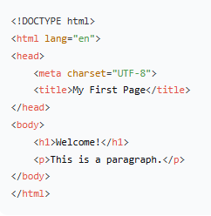
Anatomy of an HTML Page

Slide 15
Essential HTML Building Blocks
Headings: <h1>, <h2>, <h3>
Paragraph: <p>
Links: <a href="...">Visit</a>
Images: <img src="image.jpg" alt="Description">
Lists: <ul>, <ol>, <li>
Division: <div>
Span: <span>

Slide 16
Giving Meaning to Your Content
Tag | Purpose
<header> | Top section or site header
<nav> | Navigation links
<section> | Thematic grouping of content
<article> | Self-contained content
<footer> | Footer or copyright info
<main> | Main page content

Slide 17
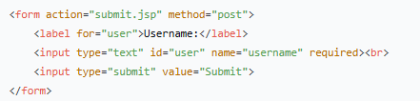
Collecting User Input

Slide 18
CSS – Cascading Style Sheets
Controls the presentation (look and feel).
Defines colors, sizes, layouts, animations.
Cascading: Priority order of styles.
Style Sheets: A set of styling rules.

Slide 19
How to Apply Styles
Inline CSS: Inside an HTML tag.
<p style="color: blue;">Text</p>
Internal CSS: Inside <style> tag in <head>.
External CSS: In a separate .css file (Recommended).
<link rel="stylesheet" href="styles.css">

Slide 20
The Language of Style
    selector {
    property: value;
    }
    Example
    h1 {
color: darkblue;
text-align: center;
}

Slide 21
What Can You Style?
Text: color, font-size, text-align
Background: background-color, background-image
Box Model: margin, padding, border
Layout: display, position, flexbox, grid

Slide 22
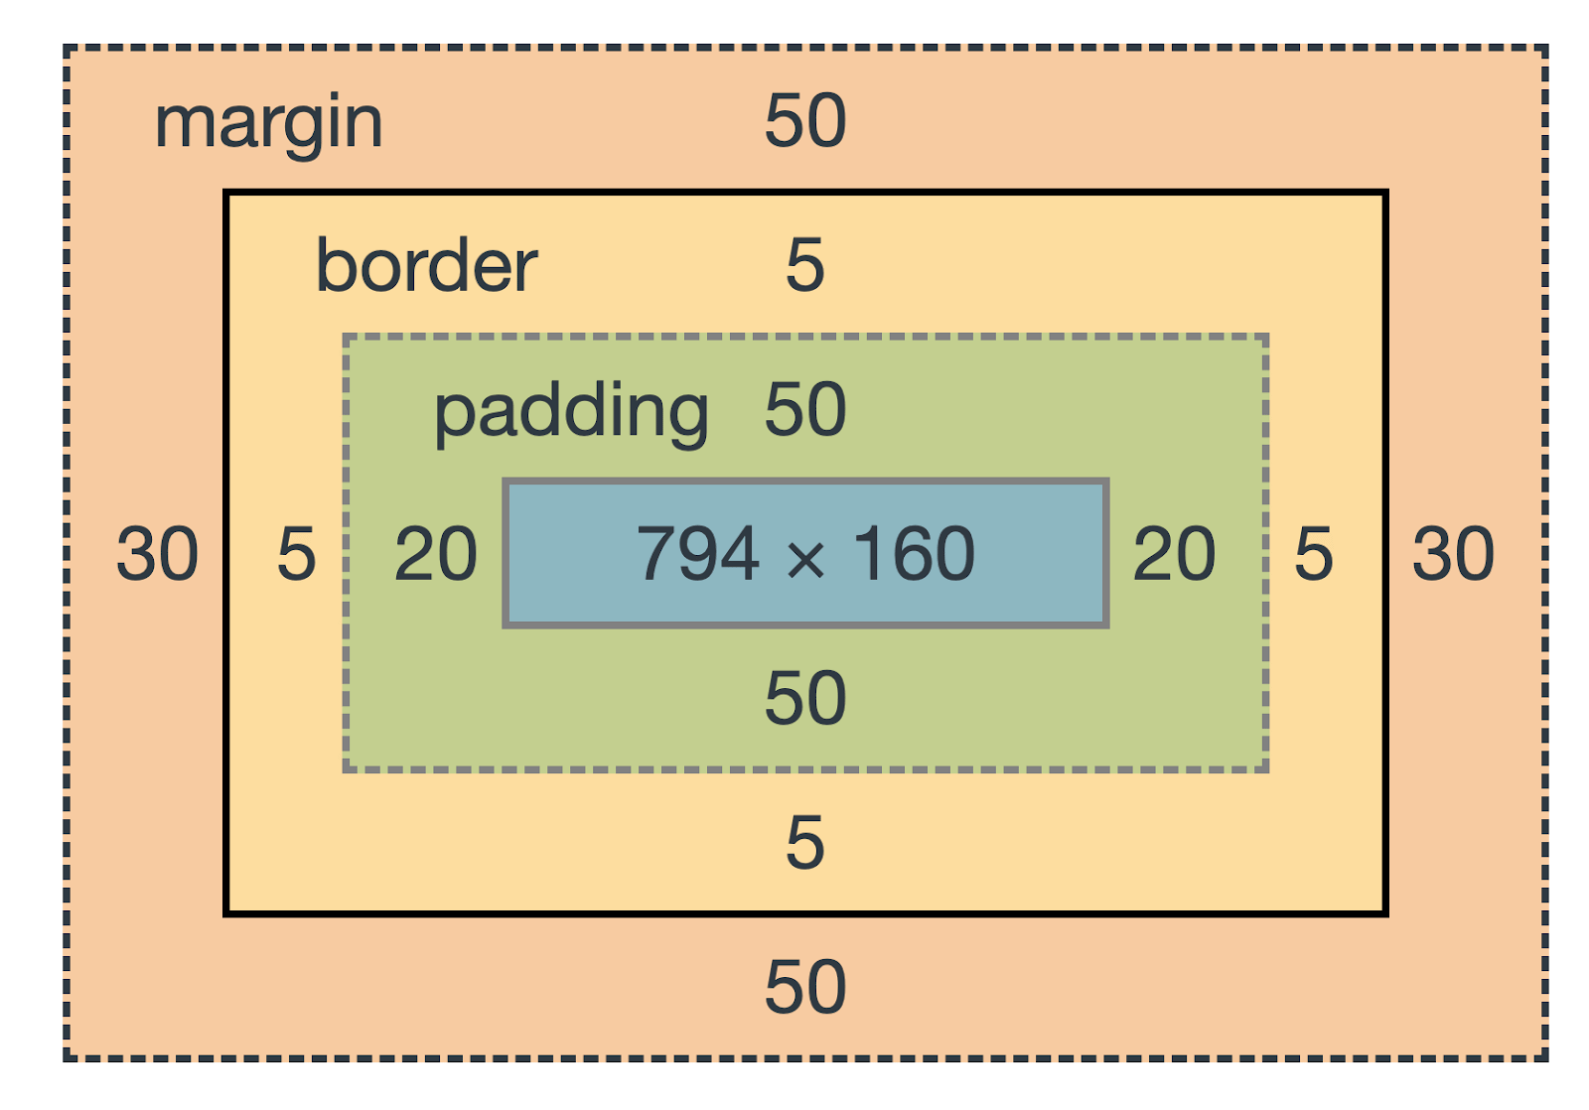
Understanding Element Layout
Every element is a box with:
Content (The core)
Padding (Space inside the border)
Border
Margin (Space outside the border)

Slide 23
JavaScript – Adding Behavior
Makes web pages dynamic and interactive.
HTML = Structure, CSS = Style, JS = Behavior.
Handles user events (clicks, form submissions).
Can manipulate HTML & CSS in real-time.

Slide 24
Placing Your Code
Inline: Inside HTML tags (onclick).
Internal: Inside <script> tags in HTML.
External: In a separate .js file (Best Practice).
<script src="script.js"></script>

Slide 25
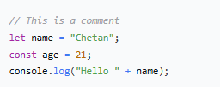
Syntax & Variables
let: For variables that can change.
const: For constant values.

Slide 26
Types of Data
Type | Example | Description
String | "Hello" | Text
Number | 42 | Numeric value
Boolean | true / false | Logical value
Object | { name: "John" } | Key-value pairs
Array | [1, 2, 3] | List of items

Slide 27
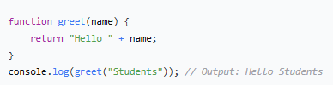
Reusable Code Blocks

Slide 28
Changing the Page Dynamically
DOM = Document Object Model (Tree structure of your HTML).
document.getElementById("demo").innerHTML = "New Text!";
document.getElementById("demo").style.color = "red";

Slide 29
Responding to User Actions
document.getElementById("myBtn").addEventListener("click", function() {
alert("Button was clicked!");
});

Slide 30
Validating Data Before Sending
Check if fields are empty.
Validate email format.
Confirm passwords match.
Show error messages to the user.

Slide 31
Summary: The Three Pillars
Layer | Language | Role
Structure | HTML | Defines content
Style | CSS | Beautifies and layouts
Behavior | JavaScript | Makes it interactive

Slide 32
Thanks!
Do you have any questions?
Thank you for your attention!
Let's start coding!

